Slide 1

Increasing Hire Heroes Donors by Geographic Locations and Social Media
By: Heran, Farres, Jonathan, Samuel, Zeeshan

Slide 2
Executive Summary

Slide 3
Problem and Motivation
Is there a geographic location within the US that most of our individual donors come from? Are there areas in the country we don't see any donors from? Do our social media posts or fundraisers calling for donations hit these areas with little to no donors?
We believe that looking into the geographic and social media/fundraising data can help Hire Heroes USA use their marketing budget more efficiently and get significantly more donations

Slide 4
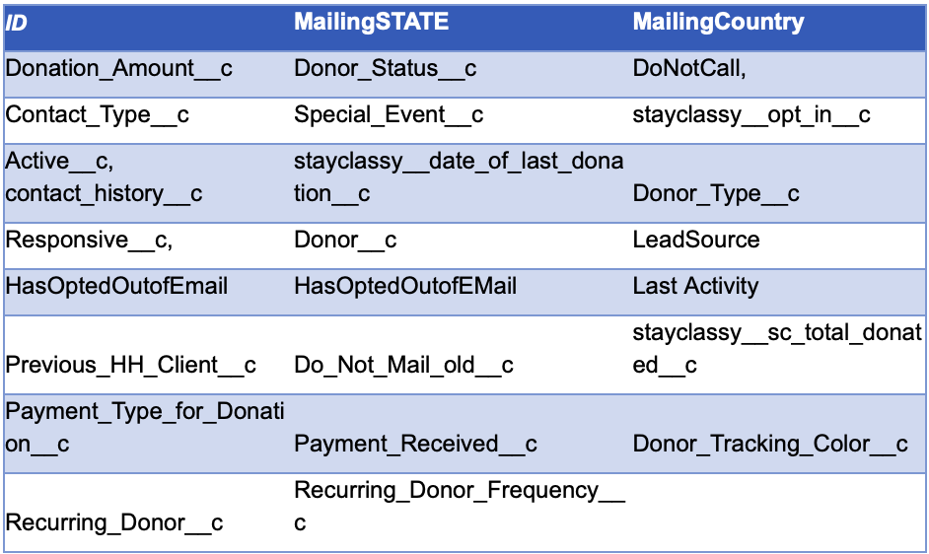
Approach
Increased marketing in low donating states
Utilized columns required in our analysis
Utilizing various data mining software to create diagrams and figures.

Slide 5
Tools and Analytics
Utilized Excel
Conversion of CSV files into Excel
Fixed MailingState Column Abbreviations
Removed Anomalies that were not states in the US
Utilized Tableau
Plugged Excel File into Tableau
Removed unnecessary data
Created geographic maps & tables
Notes:
Cleaned Data:
Converted CSV files into excel documents
Changed mailing states to be all abbreviations In excel
plugged the file into tableau and merge any states i missed into abbreviations
removed anomalies that were states in the us
selected the data we need (look in reference at reference 1)
created geographic maps, tables, and excel tables using the cleaned data

Slide 6
Results

Slide 7
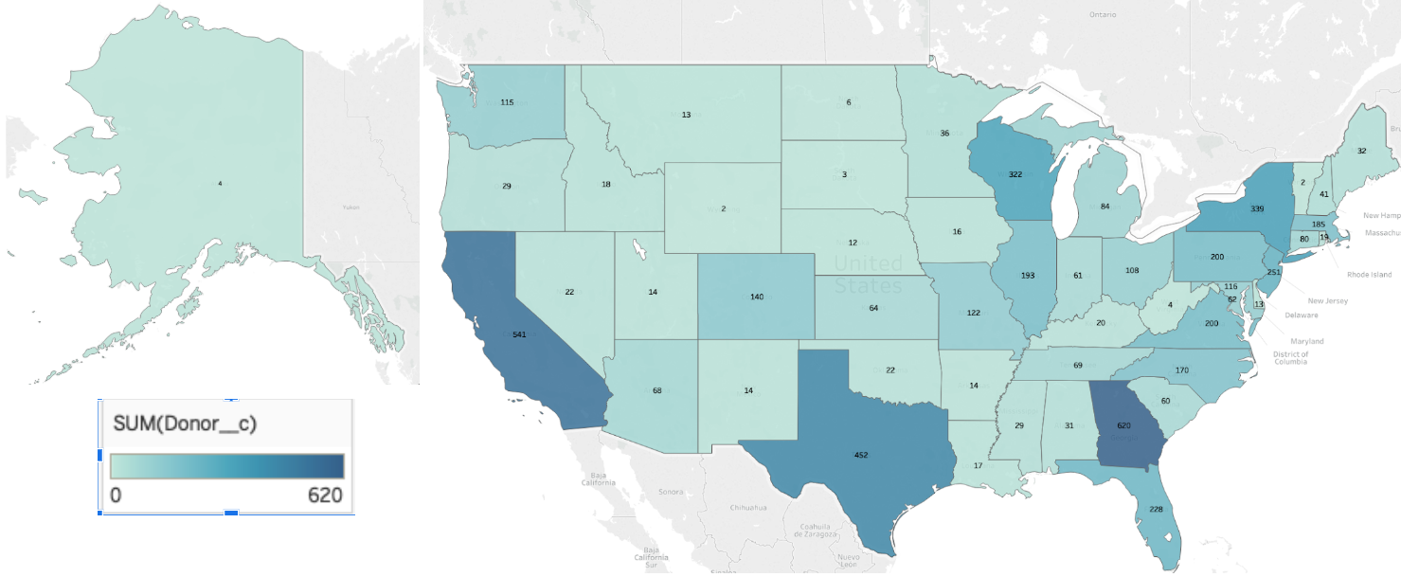
Donors Per State

Slide 8
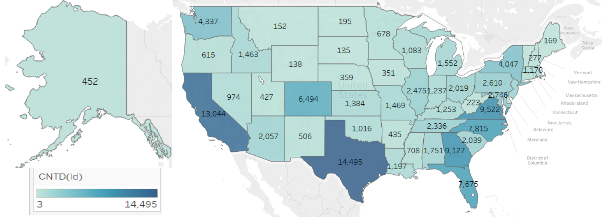
Members Per State

Slide 9
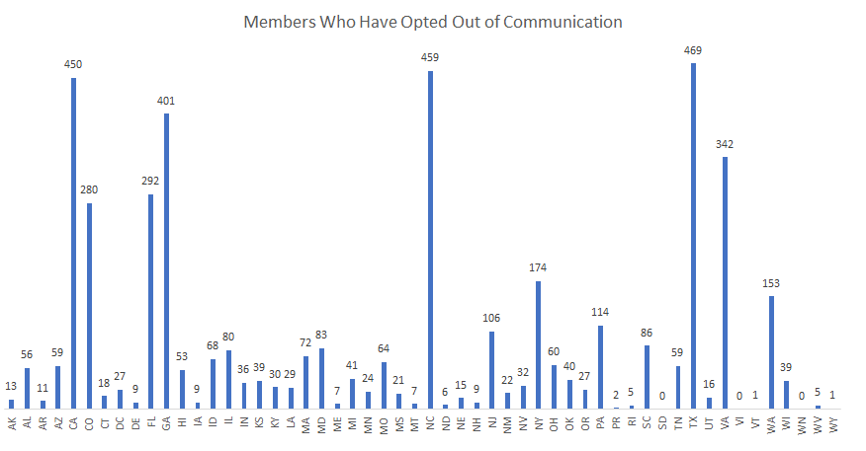
Members Who Have Opted Out

Slide 10
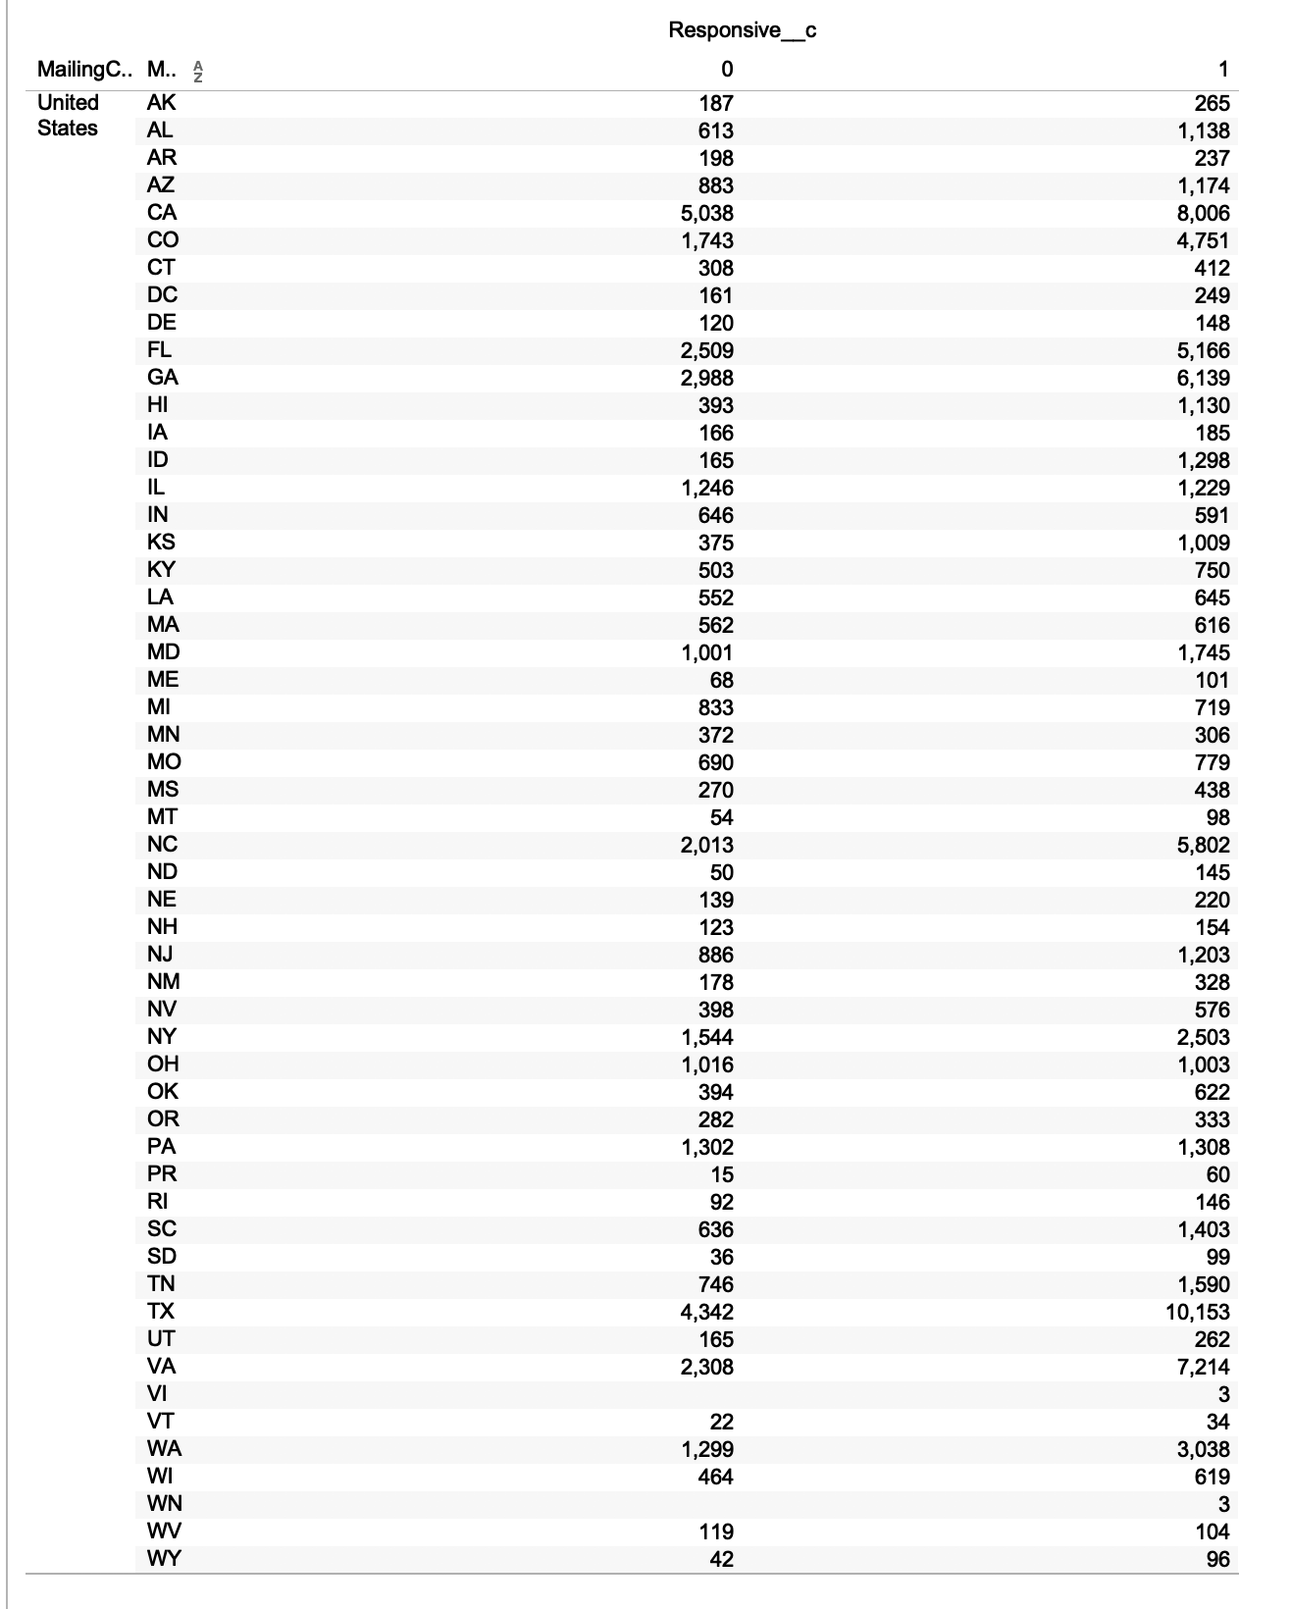
Responsive Members Per State

